Slide 1
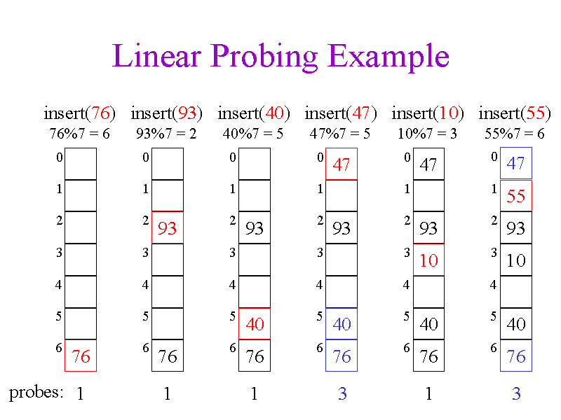
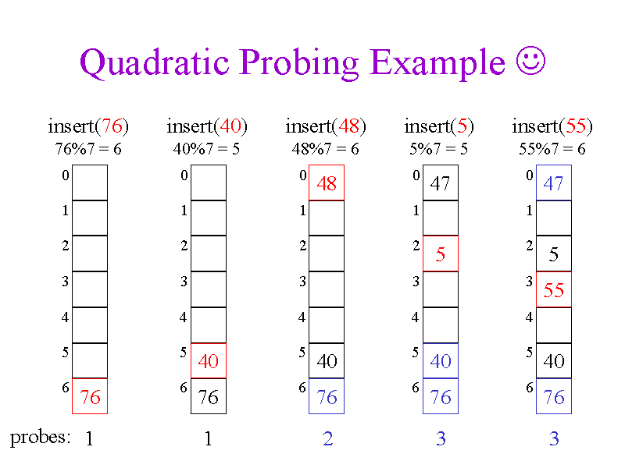
Characteristics of Linear and Quadratic Probing

Slide 2
Comparison between Linear Probing Vs Quadratic Probing
Linear Probing:
- faster implementation than quadratic probing
- use few probes
- a problem occurs known as primary clustering
interval between probes is fixed-often at 1
Quadratic Probing:
- easy to implement and deploy but slower than Linear Probing
- use extra memory for links and it does not probe all location in the table.
- a problem occurs known as secondary clustering
- interval between probes increases proportional to the hash value.

